Slide 1
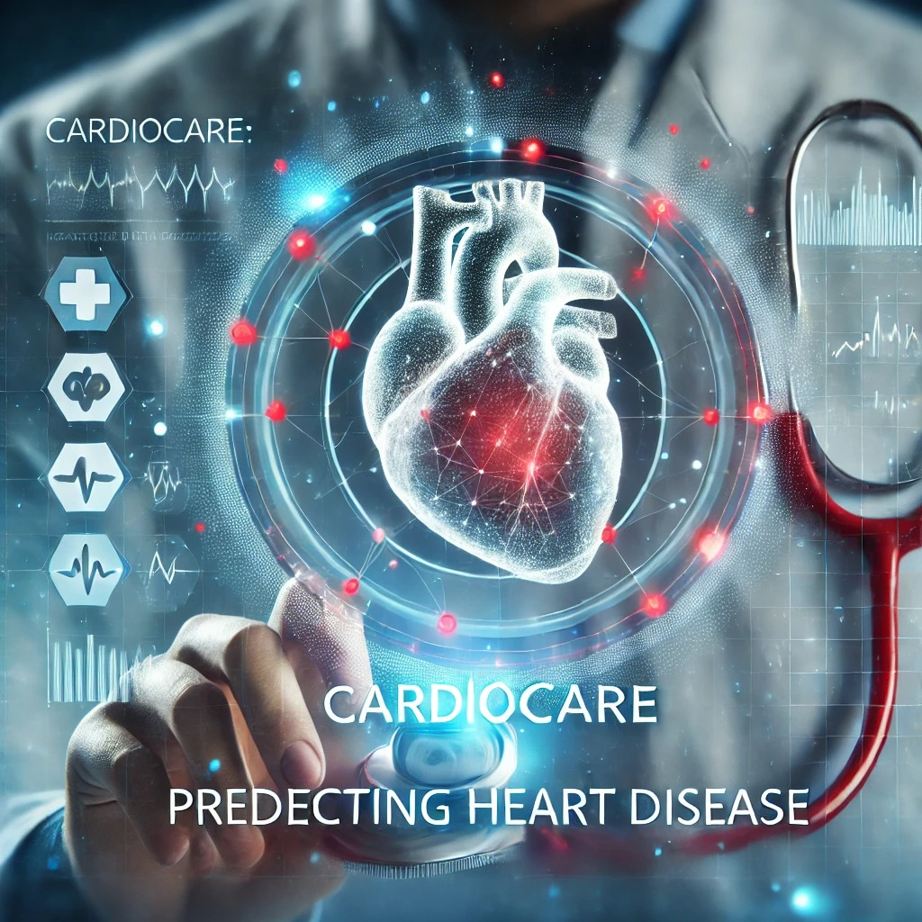
cardio Care: predicting heart disease

Slide 2
MEET OUR TEAM
Raveeha Mohsin
(2022-CS-149)
Assigned Task:
Trained and tested the machine learning model. Developed the application, integrating the predictive model and UI.
Tayyaba Afzal
(2022-CS-134)
Assigned Task:
Managed the KPIs to ensure project goals were met.
Gathered the necessary data for model training and evaluation.

Slide 3
Overview
Data Gathering
Data Preprocessing
Model Application
Class Imbalance Check
Model Accuracy Evaluation
OCR Model Development
Frontend Development
Backend Development
Integration

Slide 4
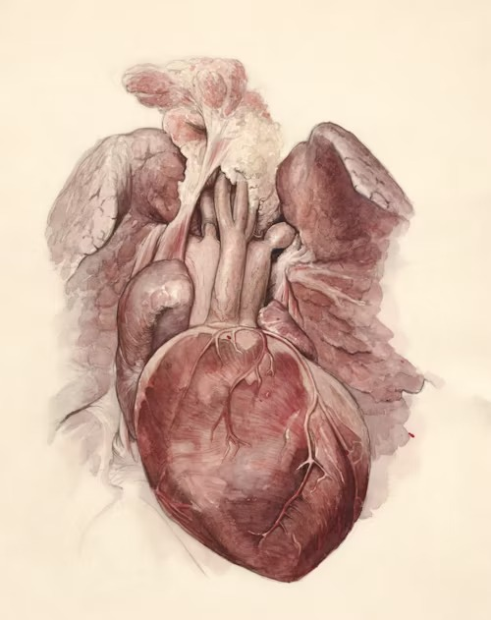
Introduction
Heart Disease Overview: Leading cause of death worldwide, including conditions like coronary artery disease, heart attacks, and arrhythmias.
Importance of Early Prediction: Early detection helps in preventing severe health complications and enables timely intervention.
Objective: Develop a system that uses patient health data to predict the risk of heart disease.

Slide 5
PROBLEM STATEMENT
Challenges of Early Diagnosis and Prevention
Prevalence of Heart Disease
Importance of Predictive Healthcare Solutions
. Heart disease remains one of the leading causes of death worldwide, affecting millions each year. It puts a significant strain on healthcare systems due to high treatment costs and long-term care.
Heart disease often develops silently without noticeable symptoms, making early detection difficult. Lack of widespread access to regular screenings and preventive measures increases the risk for undiagnosed cases.
Predictive models can help identify individuals at high risk, enabling earlier intervention. Leveraging data and AI can provide accurate risk assessments and guide personalized treatment plans.

Slide 6
Solution Overview - Business Objective
To develop a predictive healthcare system—CardioCare—that helps individuals assess their risk of heart disease based on various health metrics.
The aim is to provide early diagnosis tools that can potentially save lives, reduce healthcare costs, and improve patient outcomes.
The system leverages advanced AI/ML models to deliver accurate predictions and actionable insights, enabling proactive interventions in heart disease prevention.

Slide 7
Node.js
Used for the backend to handle user data, processing requests, and generating predictions.
React
For building the responsive and interactive user interface
AI/ML
Machine learning models to analyze health data and make predictions.
Technologies Used

Slide 8
Illustrating the Flow

Slide 9
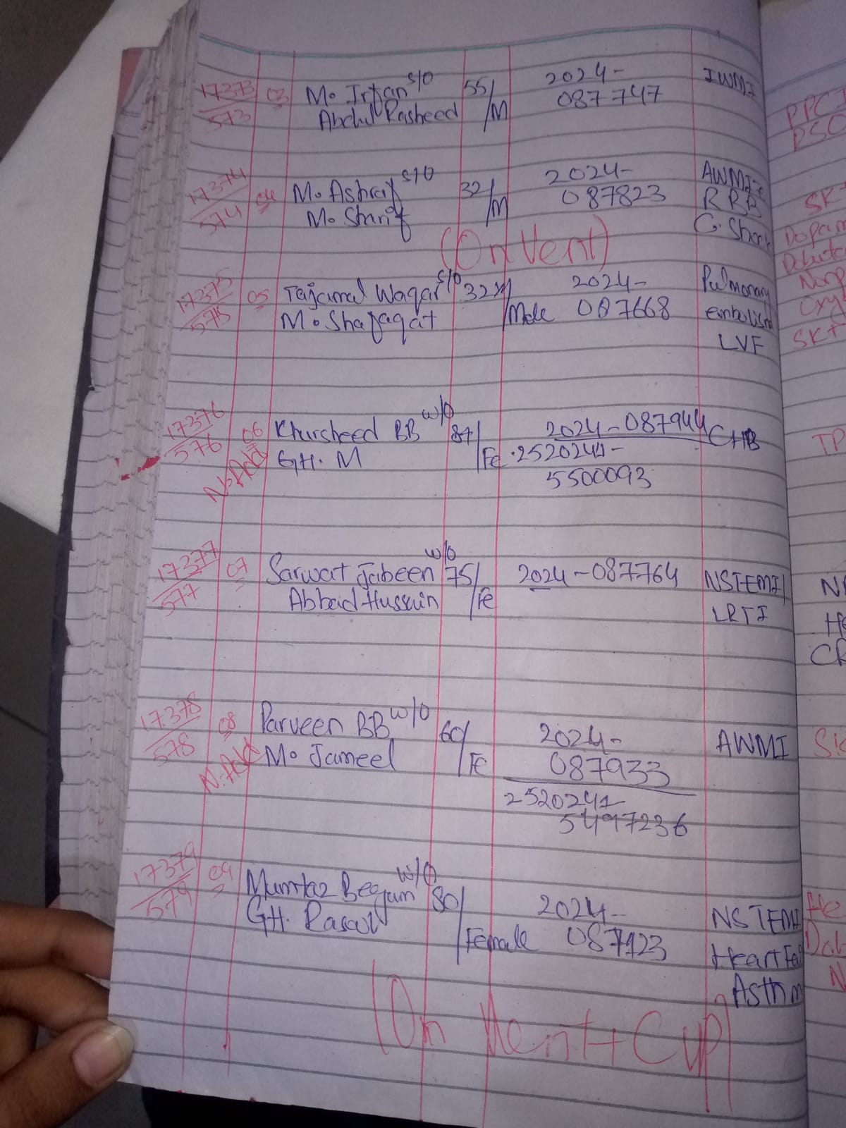
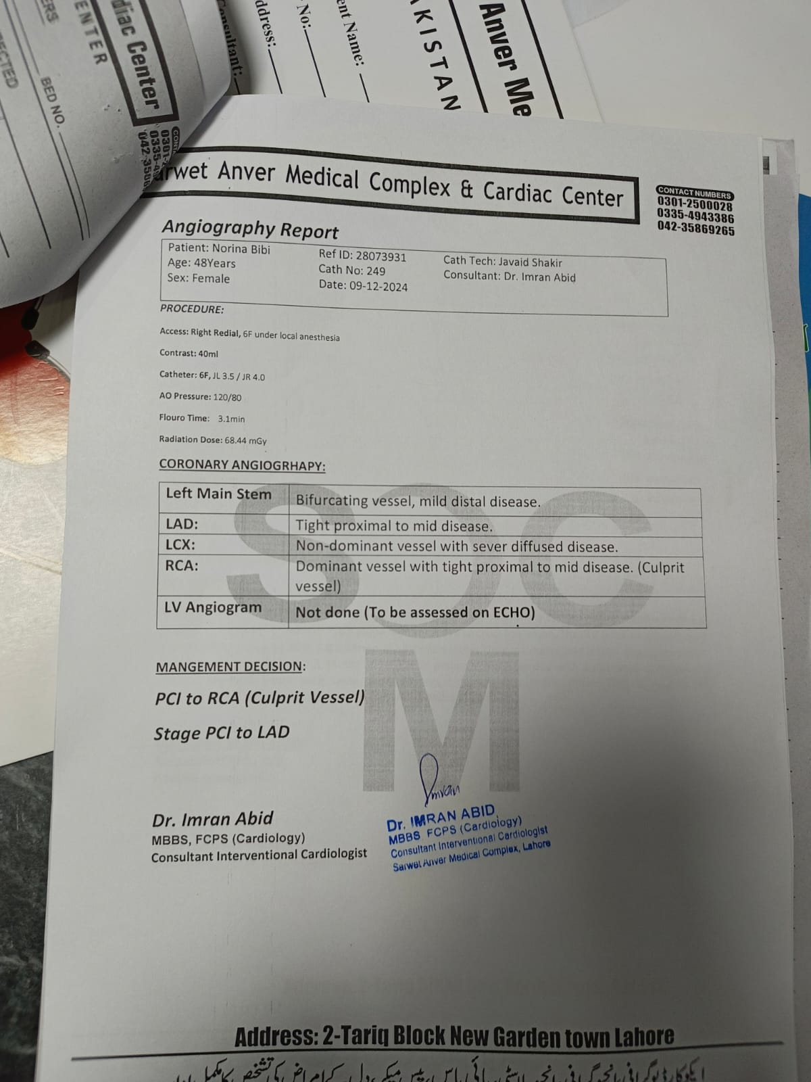
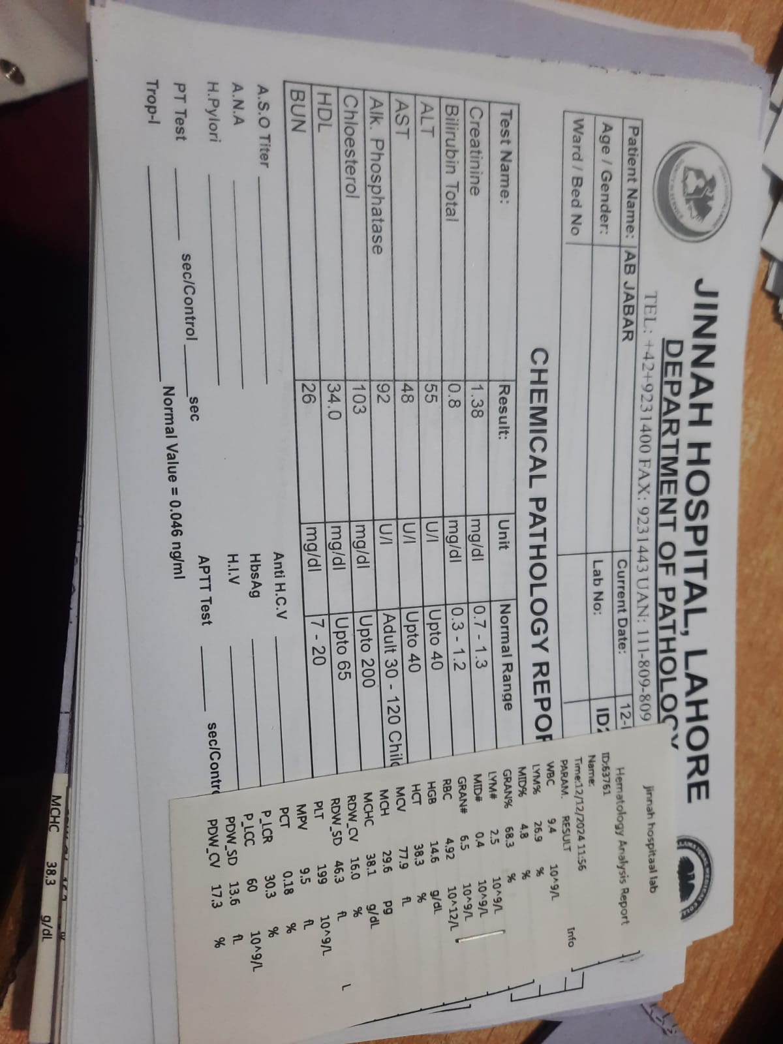
KEY PERFORMANCE INDICATOR
PIC DATASET
SARWAT ANWAR DATASET
JINNAH DATASET

Slide 10
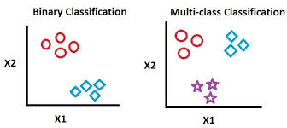
Machine Learning Approach - Multi-class Classification
We started with two datasets, which we merged to create a comprehensive dataset for heart disease prediction.
Initially, we were working with a binary classification model (heart disease: yes/no), but we adapted our model to a multi-class classification using N clusters to account for different levels of risk (e.g., low, medium, high, very high).
This transformation allowed us to more effectively classify patients based on their risk levels, providing more detailed predictions.

Slide 11
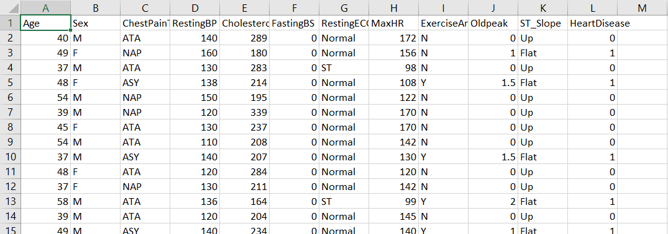
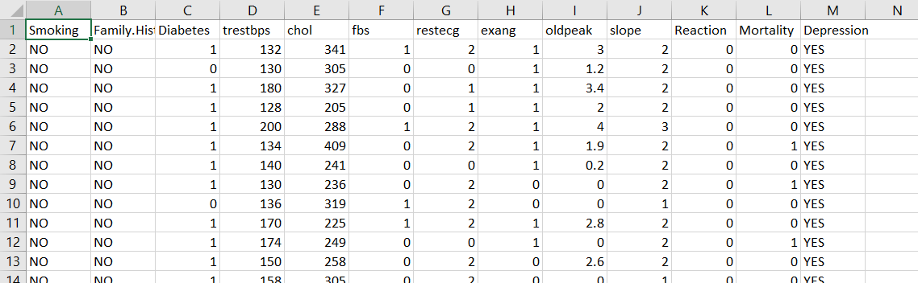
DataSet
We merged two datasets to provide a broader range of input data, improving the accuracy of our predictions.

Slide 12
Modeling - Neural Network
Best Model
Models Applied:
We experimented with multiple models, including Logistic Regression, Decision Trees, and Random Forests.
After evaluating performance metrics such as accuracy, precision, and recall, we determined that the best-performing model for this task was a Neural Network.
Performance Metrics
Accuracy: Measures the overall correctness of the model's predictions. Precision & Recall: Assess the model's ability to correctly identify heart disease risks (precision) and minimize false negatives (recall). F1 Score: A balanced measure that combines precision and recall.
Why Neural Network
The Neural Network was used for multi-class classification because it performs well with complex data and can capture non-linear relationships between input variables and the outcome. The network architecture includes multiple layers of neurons, which help the model learn from the data by adjusting weights through training

Slide 13
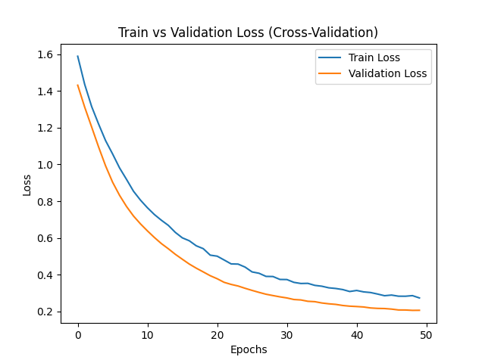
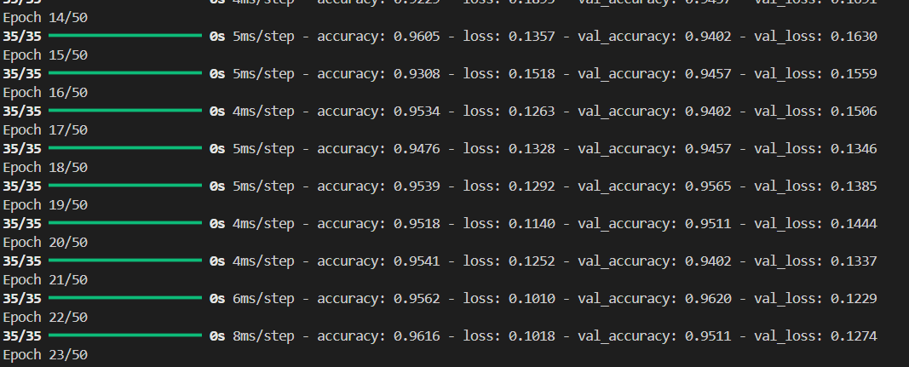
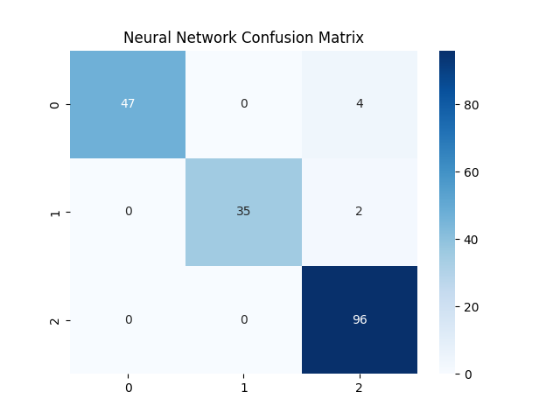
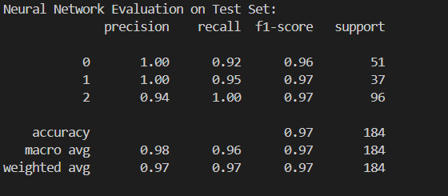
Findings

Slide 14
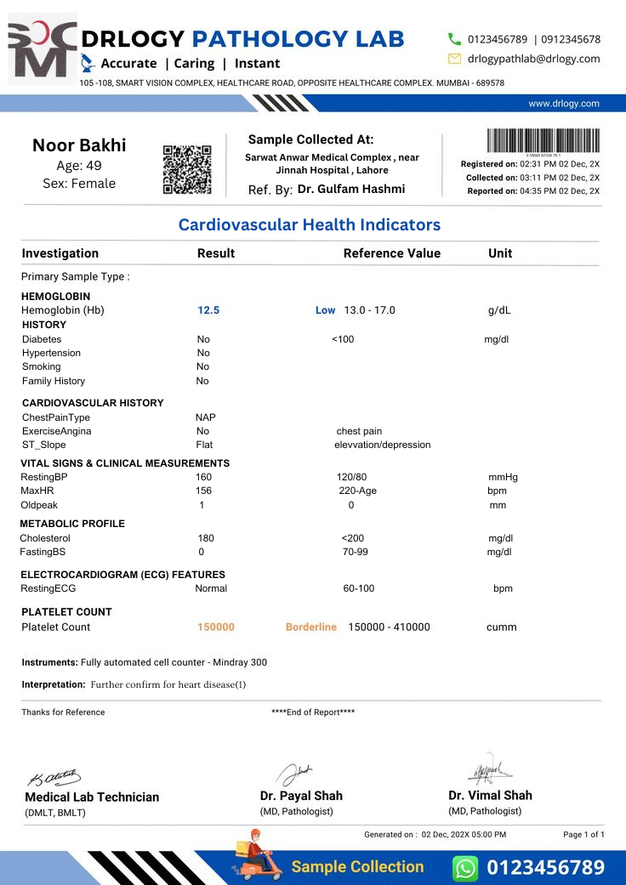
OCR MODEL
In addition to predictive analytics, we incorporated an OCR model for extracting key data from sample reports.
This model was trained to process scanned documents (e.g., medical records, health reports) and extract relevant health data automatically.
The OCR model first preprocesses the image (e.g., noise reduction, resizing).
It then uses machine learning techniques to recognize and extract text from images of the reports, which can then be used for prediction.

Slide 15

UI-Interfaces – Authentication

Slide 16
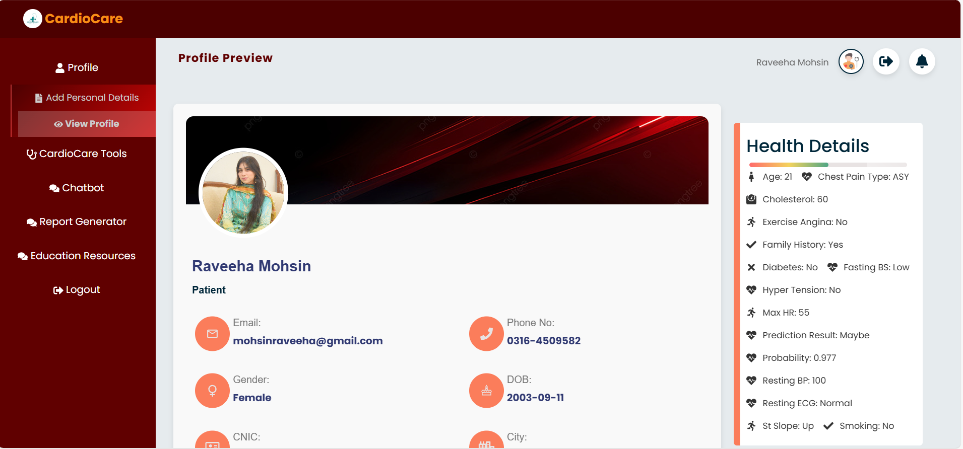
UI-Interfaces – View your profile

Slide 17
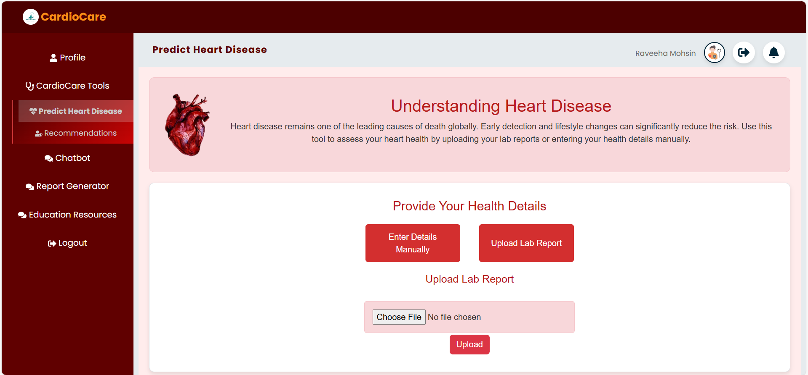
UI-Interfaces – Predict Heart Disease

Slide 18
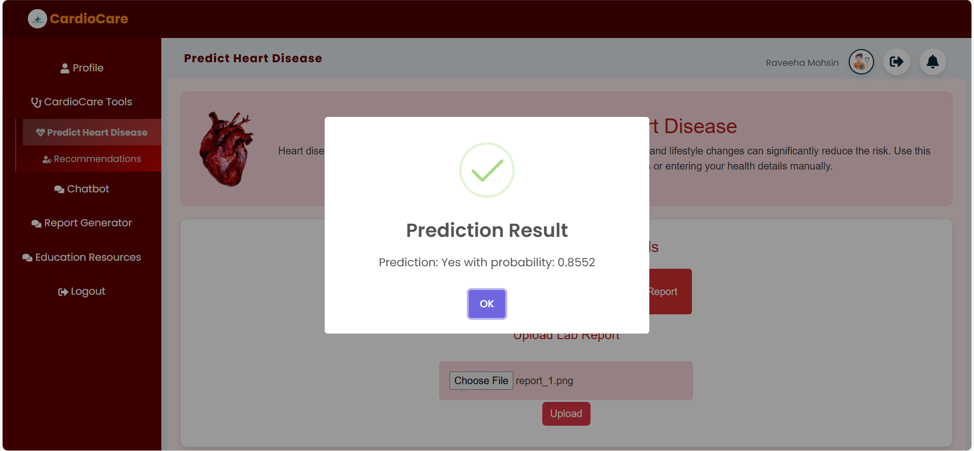
UI-Interfaces – Results

Slide 19
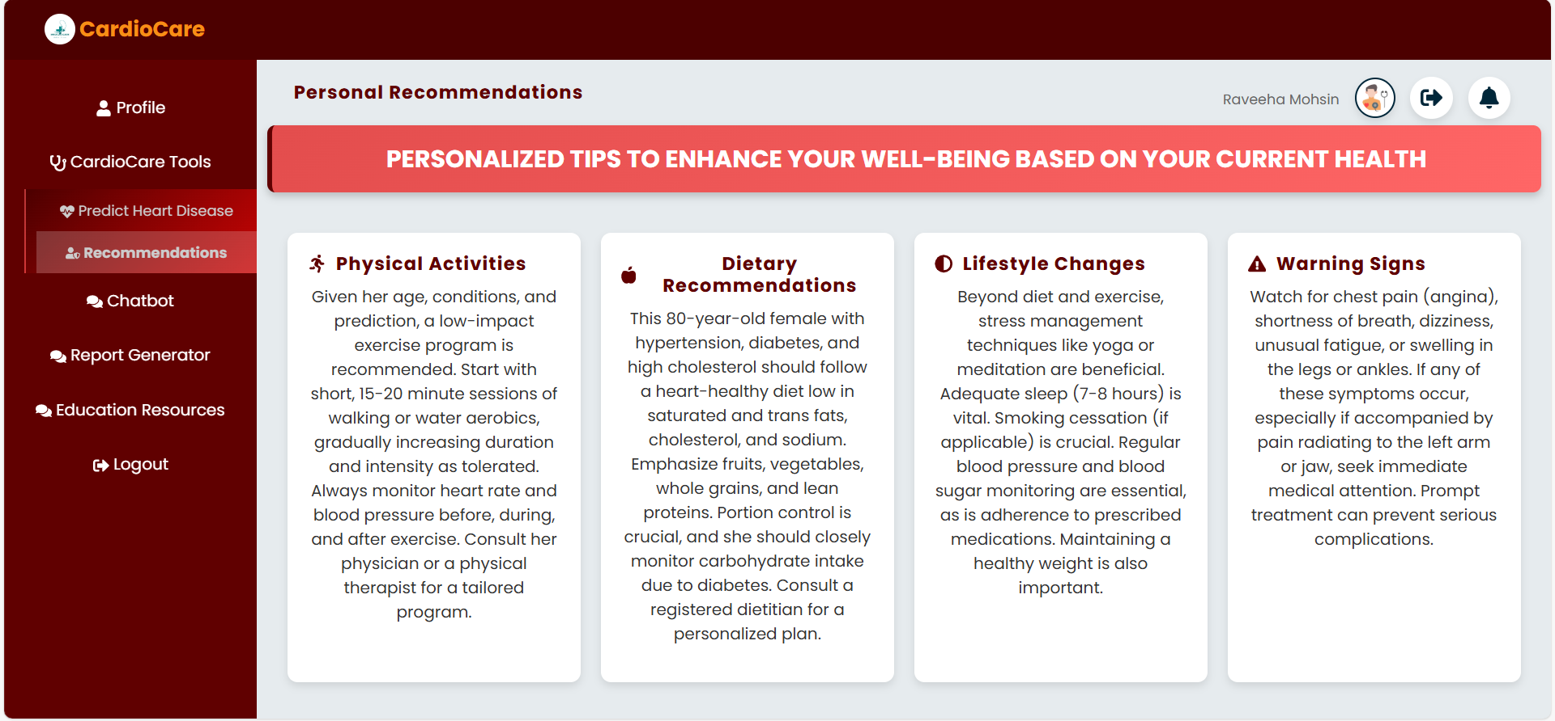
UI-Interfaces – Personalized Tips

Slide 20
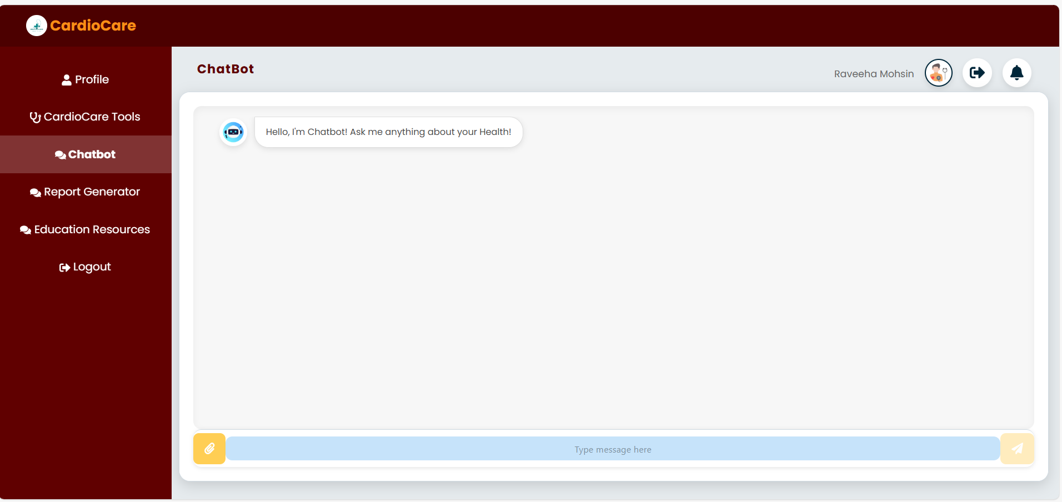
UI-Interfaces – Chatbot Integration

Slide 21

Technical Challenges
Ensuring Accurate Predictions
Data Collection
Maintaining high accuracy while preventing overfitting of the model was a key challenge. Early versions of the models showed signs of overfitting, where the model performed well on the training data but poorly on new, unseen data.
Solution: To address this, we applied regularization techniques, used cross-validation to ensure generalization, and fine-tuned model hyperparameters to achieve a balance between bias and variance.
Data collection for health metrics such as cholesterol, age, and heart rate presented challenges in terms of obtaining clean, diverse, and representative data. Incomplete or biased data could affect the model's performance.
Solution: We ensured that the data collected was preprocessed for missing values and outliers. We also merged two different datasets to increase the diversity and reliability of the data, improving the robustness of the model.

Slide 22
Future Enhancements
Integrating with Wearable Devices
A key enhancement would be to integrate the system with wearable devices such as smartwatches or fitness trackers. This would allow for the collection of real-time health data like heart rate, blood pressure, and physical activity.
Future Plan: By linking wearable devices to the system, we could continuously monitor a patient’s health and provide real-time heart disease risk predictions and personalized recommendations.

Slide 23
Conclusion
Early detection and prevention of heart disease can lead to better health outcomes and reduced healthcare costs. Using AI for heart disease prediction enables personalized, data-driven healthcare.
Acknowledgments
We thank our mentors and collaborators for their invaluable guidance. We appreciate the datasets and technologies that made this project possible.
Key Points
Importance
This project uses AI and machine learning to predict heart disease risk and provide personalized recommendations through a Neural Network for multi-class classification

Slide 24
Thank You

